Slide 1

WEB MINI PROJECT
Under the guidance of:-
Mrs. Pragathi Manjunath
Assistant Professor
Dept. of CSE
RGIT, Bangalore-560032
EXPENSE TRACKER
BY:-
MOHAMMED TOUSEEF(1RG17CS031)
TANZIL PASHA(1RG17CS059)

Slide 2
AGENDA
ABSTRACT
SYSTEM REQUIREMENT
ABOUT THE PROJECT
IMPLEMENTATION
SNAPSHOTS
FUTURE ENHANCEMENT
CONCLUSION
REFERENCE BOOKS

Slide 3
ABSTRACT
Expense tracker is a web page that helps us to keep an accurate record of your money inflow and outflow.
Using a daily expense manager can help you keep track of how much you spend every day.

Slide 4
SYSTEM REQUIREMENT
HARDWARE REQUIREMENTS:
Processor : Intel pentium
RAM : 1 GB
HDD Capacity : 50 GB
Display : VGA Monitor
Keyboard , Mouse.
SOFTWARE REQUIREMENTS:
Operating System : WINDOWS 7/8/10
Microsoft Visual Studio 2010
MySQL

Slide 5
ABOUT THE PROJECT
Daily Expense Tracker System is a system which will keep a track of Income-Expense on a day to day basis, This system takes income and divides in daily expense.
Daily expense tracking system will generate report at the end of month to show income expense.
It will let you add a savings amount which you had saved for some particular festivals or day like birthday or anniversaries.

Slide 6
IMPLEMENTATION

Slide 7
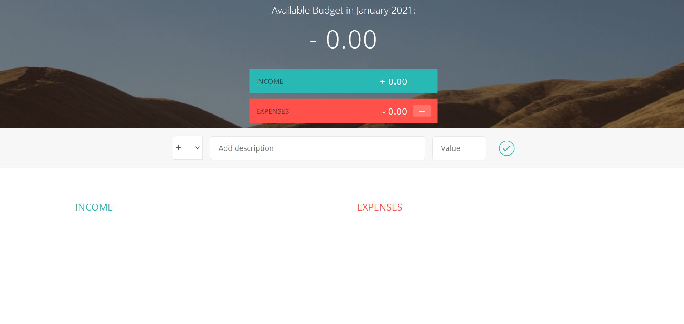
SNAPSHOTS

Slide 8
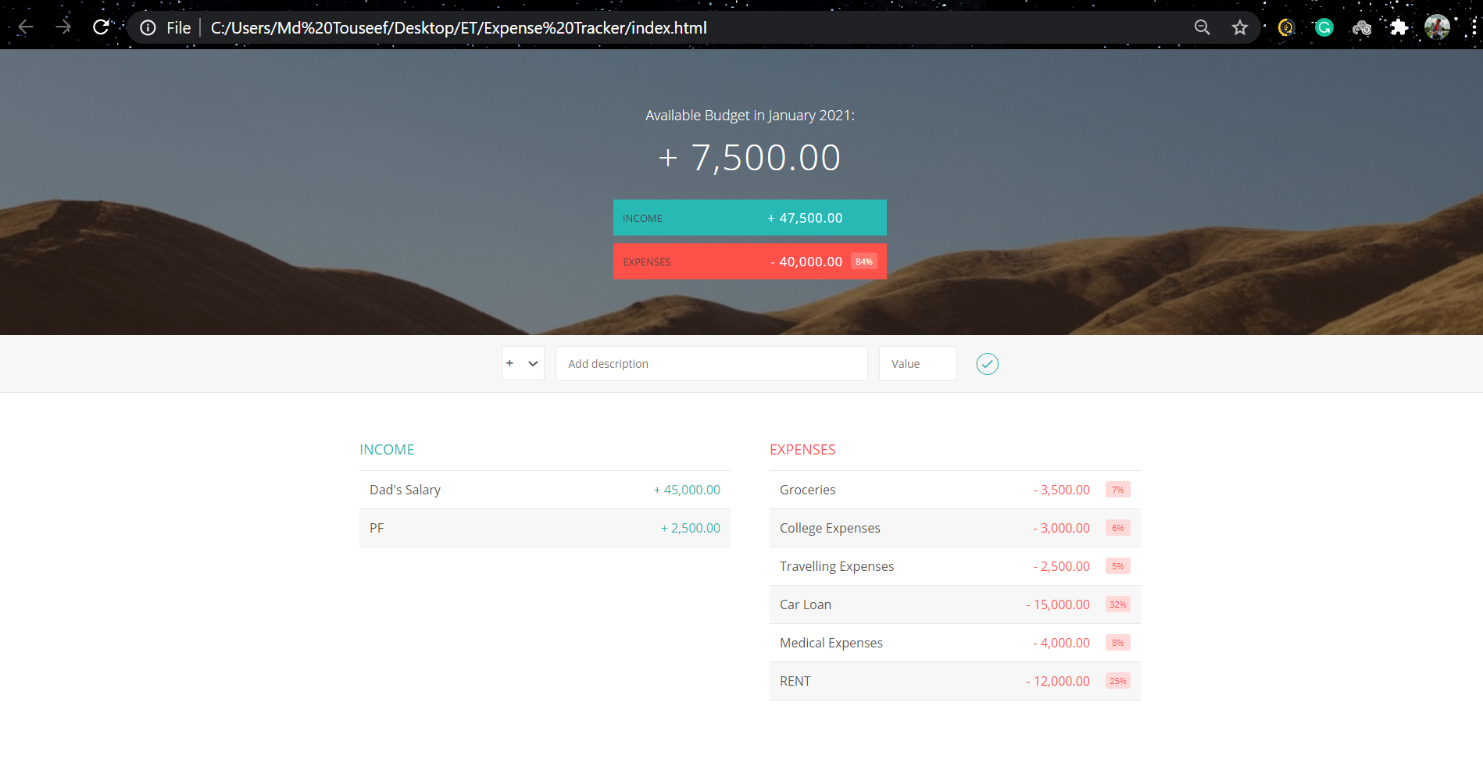

Slide 9
FUTURE ENHANCEMENTS
In the future, The Online Income and Expense Tracker application can be further enhanced to include features like:
The application can be extended to include scanning of barcode on the price tag which decreases the effort of entering the data in the input fields.

Slide 10
CONCLUSION
After making this web page we assure that this web page will help its users to manage the cost of their daily expenditure.
It will guide them and aware them about their daily expenses.
It will prove to be helpful for the people who are frustrated with their daily budget management.
In short, this will help its users to overcome the wastage of money.

Slide 11
REFERENCE BOOKS
Text Books:-
Randy Connolly,Ricardo Hoar,”Fundamentals of Web Development,1st Edition,Pearson Education India.
Luke Welling,Laura Thomson,PHP and MySQL Web Development,5th Edition,Pearson Education,2016.
Nicholas C Zakas,Professional JavaScript for Web Developers,3rd Edition,Wrox/Wiley India,2012.
Websites Referred:-
HTML : https://www.tutorialspoint.com/index.html
CSS : https://www.w3schools.com/css/default.asp
JS : https://www.w3schools.com/js/default.asp

Slide 12
THANK YOU

